Slide 1
AWT
Abstract Window Toolkit

Slide 2
AWT
AWT (Abstract Windowing Toolkit) is an API to develop GUI or window-based application in java.
Java AWT components are platform-dependent i.e. components are displayed according to the view of operating system. AWT is heavyweight i.e. its components uses the resources of system.
The java.awt package provides classes for AWT api such as
1. TextField
2. Label
3. TextArea
4.RadioButton
5. CheckBox
6. Choice
7. List etc.

Slide 3
Note
For your kind information
To develop rich GUI applications , JavaFX is used.
AWT and SWING are deprecated

Slide 4
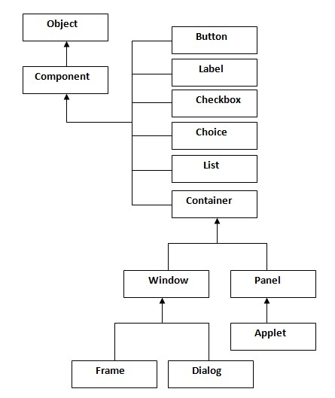
AWT Hierarchy

Slide 5
Container
The Container is a component in AWT that can contain another components like buttons, textfields, labels etc. The classes that extends Container class are known as container such as Frame, Dialog and Panel.

Slide 6
Window
The window is the container that have no borders and menu bars. You must use frame, dialog or another window for creating a window.

Slide 7
Panel
The Panel is the container that doesn't contain title bar and menu bars. It can have other components like button, textfield etc.

Slide 8
Frame
The Frame is the container that contain title bar and can have menu bars. It can have other components like button, textfield etc.

Slide 9
Useful Methods of Component class
Method | Description
public void add(Component c) | inserts a component on this component.
public void setSize(int width,int height) | sets the size (width and height) of the component.
public void setLayout(LayoutManager m) | defines the layout manager for the component.
public void setVisible(boolean status) | changes the visibility of the component, by default false.

Slide 10
AWT Example
To create simple awt example, you need a frame. There are two ways to create a frame in AWT.
By extending Frame class (inheritance)
By creating the object of Frame class (association)

Slide 11
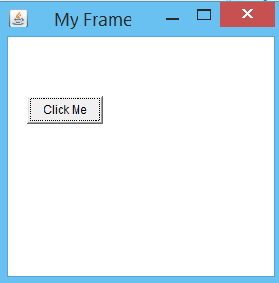
My Frame Example

Slide 12
MyFrame.java
public class MyFrame extends Frame {
public MyFrame() {
setTitle("My Frame"); // setting title of the frame
Button button = new Button("Click Me");
button.setBounds(30,100, 80, 30); // setting position
add(button); // adding button to frame
setLayout(null); // no layout manager
setVisible(true); // making frame is visible, by default it is invisible
setSize(300, 300); // setting size of the frame
}
public static void main(String[] args) {
MyFrame mf = new MyFrame();
}
}

Slide 13
Simple Example of AWT by Association
public class MyFrame {
public MyFrame() {
Frame f = new Frame();
f.setTitle("My Frame"); // setting title of the frame
Button button = new Button("Click Me");
button.setBounds(30, 100, 80, 30); // setting position
f.add(button); // adding button to frame
f.setLayout(null); // no layout manager
f.setVisible(true); // making frame is visible, by default it is invisible
f.setSize(300, 300); // setting size of the frame
}
public static void main(String[] args) {
MyFrame mf = new MyFrame();
Frame f = new Frame("My new Frame");
}
}

Slide 14
Event Handling
Event and Listener

Slide 15
Event and Listener
Changing the state of an object is known as an event. For example, click on button, dragging mouse etc. The java.awt.event package provides many event classes and Listener interfaces for event handling.

Slide 16
Event classes and Listener interfaces:
Event Classes | Listener Interfaces
ActionEvent | ActionListener
MouseEvent | MouseListener and MouseMotionListener
MouseWheelEvent | MouseWheelListener
KeyEvent | KeyListener
ItemEvent | ItemListener
TextEvent | TextListener
AdjustmentEvent | AdjustmentListener
WindowEvent | WindowListener
ComponentEvent | ComponentListener
ContainerEvent | ContainerListener
FocusEvent | FocusListener

Slide 17
Steps to perform Event Handling
1. Implement the Listener interface and overrides its methods
2. Register the component with the Listener

Slide 18
For registering the component with the Listener, many classes provide the registration methods. For example:
Button
public void addActionListener(ActionListener a){}
MenuItem
public void addActionListener(ActionListener a){}
TextField
public void addActionListener(ActionListener a){}
public void addTextListener(TextListener a){}
TextArea
public void addTextListener(TextListener a){}
Checkbox
public void addItemListener(ItemListener a){}
Choice
public void addItemListener(ItemListener a){}
List
public void addActionListener(ActionListener a){}
public void addItemListener(ItemListener a){}

Slide 19
EventHandling Codes:
We can put the event handling code into one of the following places:
1. Same class
2. Other class
3. Annonymous class

Slide 20
Why does AWT Frame close?
AWT Frame is written using the native code i.e. C/C++ and is not given the functionality to close by default on clicking the close button. There may be several reasons for this, like if we create an application using the Frame class, and some operation is going on and accidentally the user clicked the close button. Then what happens, the application closes and any saved data will be lost unless if we code what to happen when user closes the window. So, it is not provided by default, not only in the AWT but also in the Swing, but in Swing if you can just notice, you will observe the frame disposing but the application doesn't close. The application keeps running in the background.

Slide 21
How can we close it?
Closing it is dead simple. All you need to know at first, is what action gets fired, when some operation on the Window is opened. It is obvious here, the WindowListener in the java.awt.event package (Ofcourse, all the AWT Event classes reside there). So it is clear i think so, that you will have to implement or write an anonymous inner class or do whatever you want to handle the operations on the AWT frame within your hands. So, in this example i will teach to just terminate (exit) the program when the close button on the Frame is clicked.

Slide 22
Code to close the window
addWindowListener(new WindowAdapter() {
@Override
public void windowClosing(WindowEvent e) {
//f.dispose();
System.exit(0);
}
});
}

Slide 23
Example to close the frame
public class CloseFrame {
public CloseFrame() {
Frame f = new Frame();
f.setTitle("Close Frame"); // setting title of the frame
Button button = new Button("Click Me");
button.setBounds(30, 100, 80, 30); // setting position
f.add(button); // adding button to frame
f.setLayout(null); // no layout manager
f.setVisible(true); // making frame is visible, by default it is invisible
f.setSize(300, 300); // setting size of the frame
f.addWindowListener(new WindowAdapter() {
public void windowClosing(WindowEvent e) {
//f.dispose();
System.exit(0);
} });}
public static void main(String[] args) {
new CloseFrame();
} }

Slide 24
Explanation
WindowAdapter: An adapter class, simply it is an abstract class that implement the WindowListener interface, it's body is not provided and we have to. The use of this is, we need not implement all the abstract methods of the WindowListener interface, instead just a method or two depending upon our need can be implemented.
Why windowClosing(WindowEvent we)? The program has to exit at the time of closing the window i.e. when the user is clicking the button. For example, if you write windowClosed instead of WindowClosing then the window will not be closed because it means to terminate the program after the window is closed and the window will never be closed unless you write it in thewindowClosing.
System.exit(0): Nothing, close the program (i.e. terminate the current running JVM) normally. The 0 says it to terminate normally.
What still? Nothing, yet one more thing, if you just want to dispose the frame instead of terminating the entire program, it is your wish as said earlier, if you, then dispose() method is for you.

Slide 25
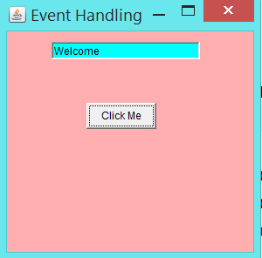
Example of event handling within class Expected Output

Slide 26
Example of event handling within class
public class MyEvent extends Frame implements ActionListener {
TextField tf;
public MyEvent() {
tf = new TextField("AMRSDGSD");
tf.setBounds(60, 50, 170, 20);
Button button = new Button("Click Me");
button.setBounds(100, 120, 80, 30);
button.addActionListener(this);
setTitle("Event Handling");
setLayout(null);
add(button);
add(tf);
setSize(300, 300);
setVisible(true);
setBackground(Color.PINK);
}
@Override
public void actionPerformed(ActionEvent e) {
tf.setBackground(Color.cyan);
tf.setText("Welcome");
}
public static void main(String[] args) {
new MyEvent();
} }

Slide 27
Example of event handling in outer class
public class MyEvent extends Frame {
TextField tf;
public MyEvent() {
tf = new TextField();
tf.setBounds(60, 50, 170, 20);
Button button = new Button("Click Me");
button.setBounds(100, 120, 80, 30);
button.addActionListener(new Outer(this));
setTitle("Event Handling");
setLayout(null);
add(button);
add(tf);
setSize(300, 300);
setVisible(true);
setBackground(Color.PINK);
}
public static void main(String[] args) {
new MyEvent();
}
}

Slide 28
Outer class
class Outer implements ActionListener{
MyEvent me;
public Outer(MyEvent me) {
this.me = me;
}
@Override
public void actionPerformed(ActionEvent e) {
me.tf.setBackground(Color.green);
me.tf.setText("Welcome");
}
}

Slide 29
Example of event handling with Anonymous class
public class MyEvent extends Frame {
TextField tf;
public MyEvent() {
tf = new TextField();
tf.setBounds(60, 50, 170, 20);
Button button = new Button("Click Me");
button.setBounds(100, 120, 80, 30);
button.addActionListener(new ActionListener() {
@Override
public void actionPerformed(ActionEvent e) {
tf.setBackground(Color.blue);
tf.setText("Welcome");
}
});
setTitle("Event Handling");
setLayout(null);
add(button);
add(tf);
setSize(300, 300);
setVisible(true);
setBackground(Color.PINK);
}
public static void main(String[] args) {
new MyEvent();
}
}

